Slide 1
Enfield Parks and Recreation
“Building Community: One Day At A Time”
Shamika Neville
Dakisha Perry

Slide 2
History of Enfield, North Carolina
Enfield, NC was founded in 1740 and is considered the oldest town in Halifax County.
Its original name of Enfield was Huckleberry Swamp.
Enfield is well known for its rich agricultural market including tobacco, cotton, soybeans, corn, and peanuts.
Enfield was once the county seat of Edgecombe County.
Enfield is the smallest town in the world to confer the eighteenth degree Mason.
Enfield had at one time five private schools (three for boys and two for girls)
The famous “Buzzard Town vs. Enfield” baseball game was held in Enfield.
Enfield now has a population of about 2300.

Slide 3

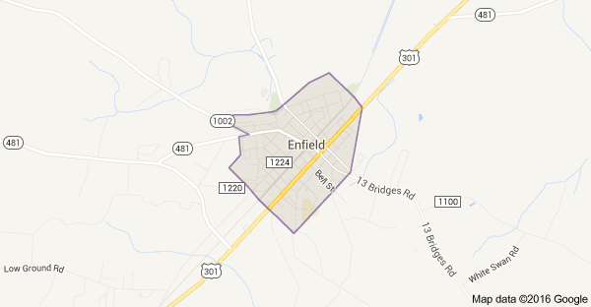
History of Enfield, North Carolina
“Though the history of Enfield’s past has faded into the pages of history, the strength of the town comes from it’s people through which the courage, faith, determination, and spirit of its pioneer builders have been handed down from generation to generation.”
Anonymous Source, History

Slide 4

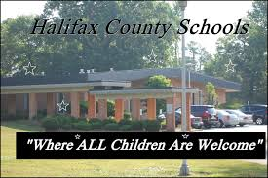


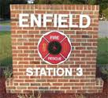

Who are important entities?

Slide 5
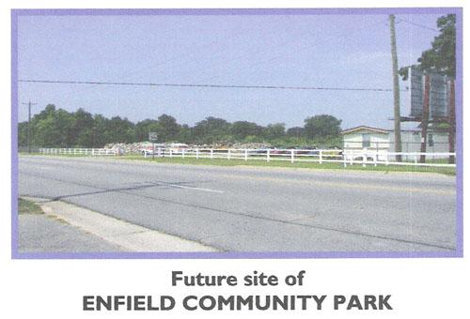
Enfield Parks and Recreation
In 2008, the town board decided to focus on a way to get the kids off the streets and help reduce crime.
The purpose is to provide recreation activities for all groups including senior citizens
Enfield Parks and Recreation is located at the old Enfield fairground.
Many organizations in the community host events at the Enfield Parks and Recreation site.

Slide 6
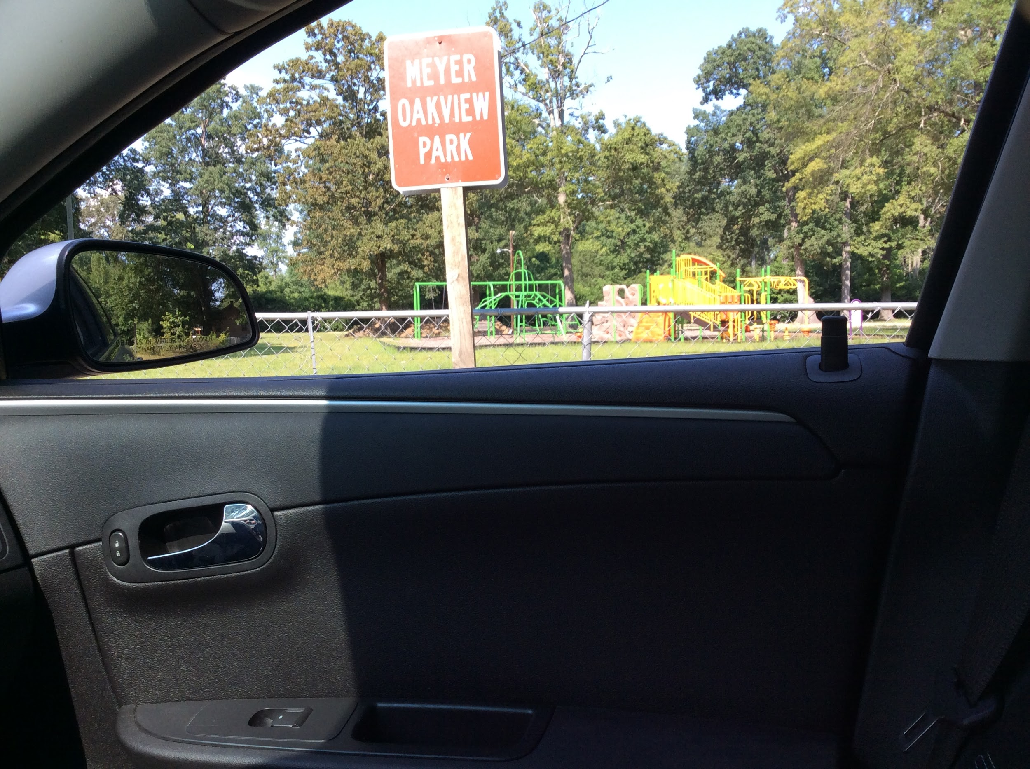
Enfield Parks and Recreation
The Enfield Town Board received a grant to renovate the fairground which is now called Enfield Community Park.
The focus is health and wellness for citizens of all ages.
The Town Board also received a grant to renovate Meyer Oakview Park which needed new equipment.
https://www.youtube.com/watch?v=YKN2VvlFCFE

Slide 7
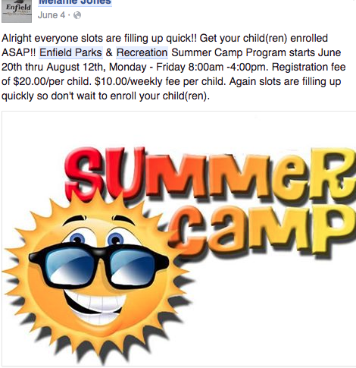
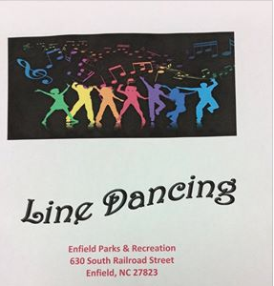
What do they offer?
Recreation Activities for all ages
Line Dance Classes each Saturday morning
Summer Camp for children ages 5-14 years
After School tutoring daily after school
Host events for families and the community
Exercise classes at 8:30 a.m. weekly
Activities to increase academic performance

Slide 8
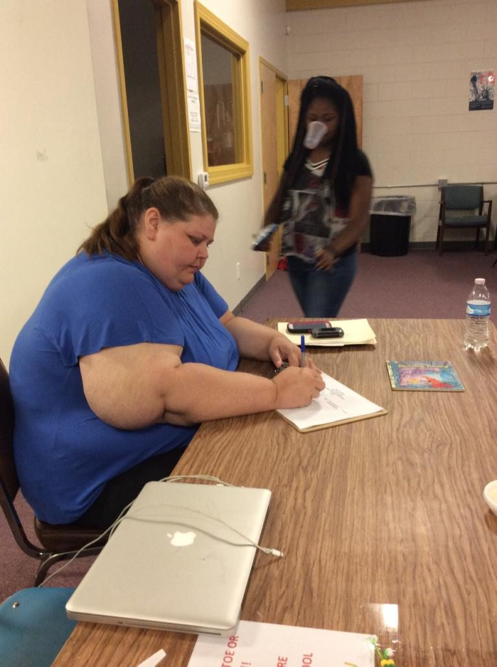
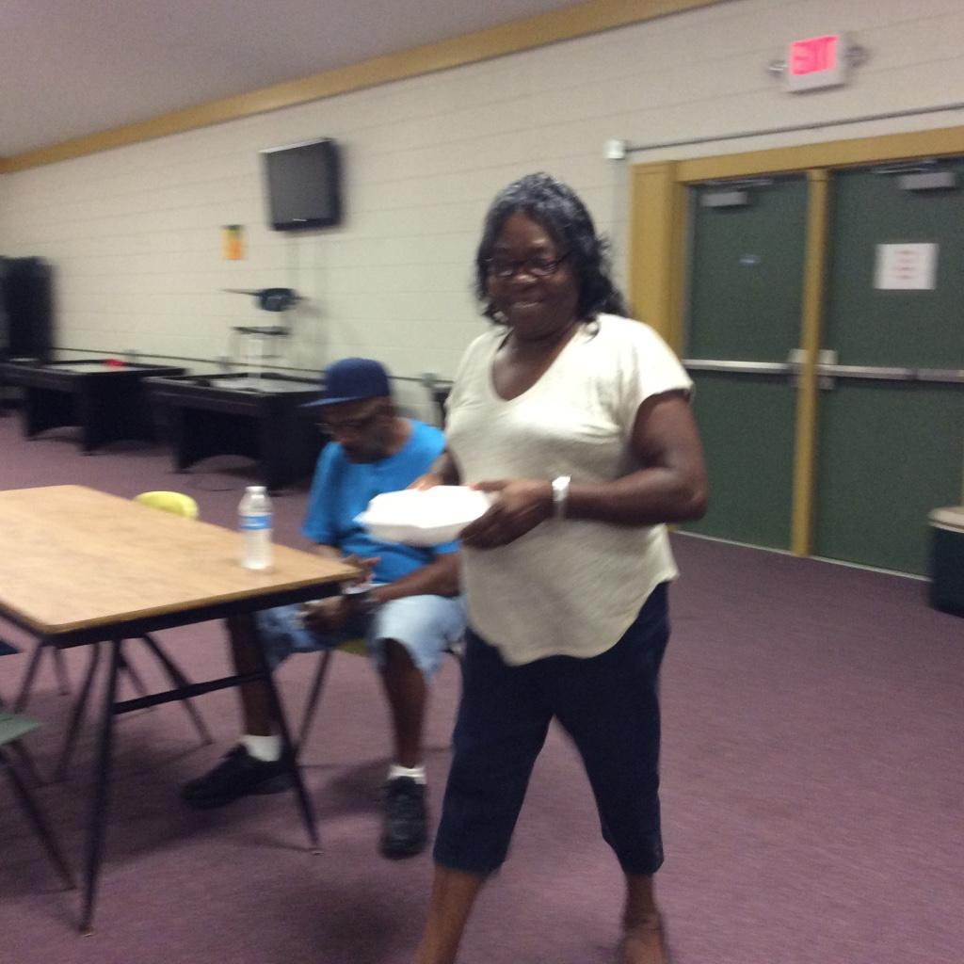
Important People
Mayor Barbara Simmons
Melanie Jones, Director, full-time
Faye Pittman, Assistant Director, part-time
Bettie Solomon, full time summer camp worker
Daryl Scott, full time summer camp worker
Diamond Moore, part time custodian

Slide 9
What is our focus?
Our main focus is to continue to aid Parks and Recreation to continue to build relationships with the community so that people will comfortable to volunteer and support the program.
To help establish some guidelines and structure for the Summer Camp including increasing the academic component
Recruit consistent volunteers for the Parks and Recreation program
Assess the needs of the program and provide the best possible service
Close the gap between the organization, schools, and community

Slide 10
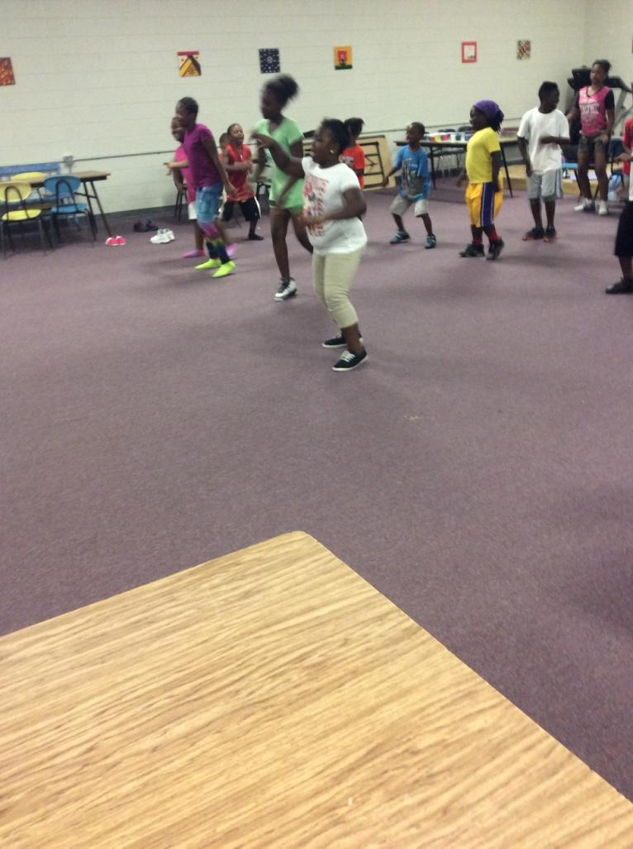
Summer Camp
8 week program for children 5-14 years of age
40 participants: 3 full-time staff; 1 part-time staff
Meals: Breakfast, lunch, and snack
$10 per week
Activities and trips weekly
Problems: Not enough staff to separate activities by age group and no reliable means of transportation to travel

Slide 11
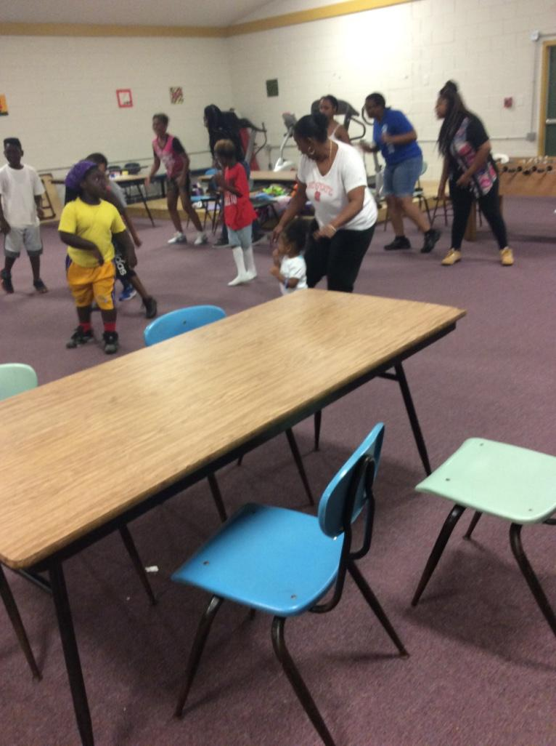
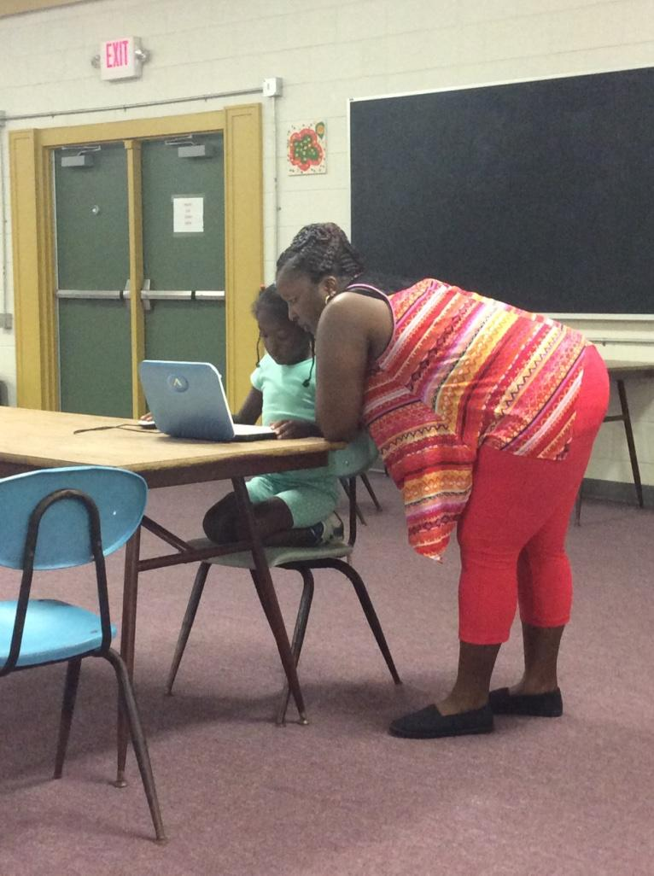
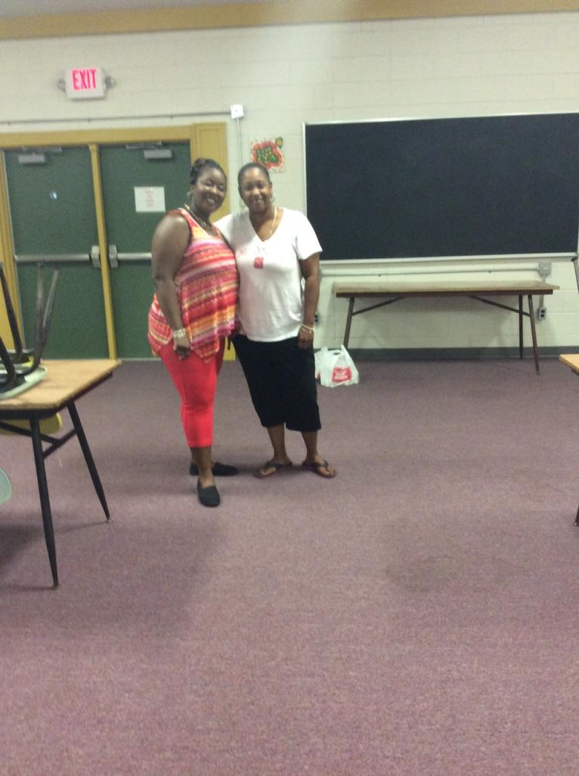
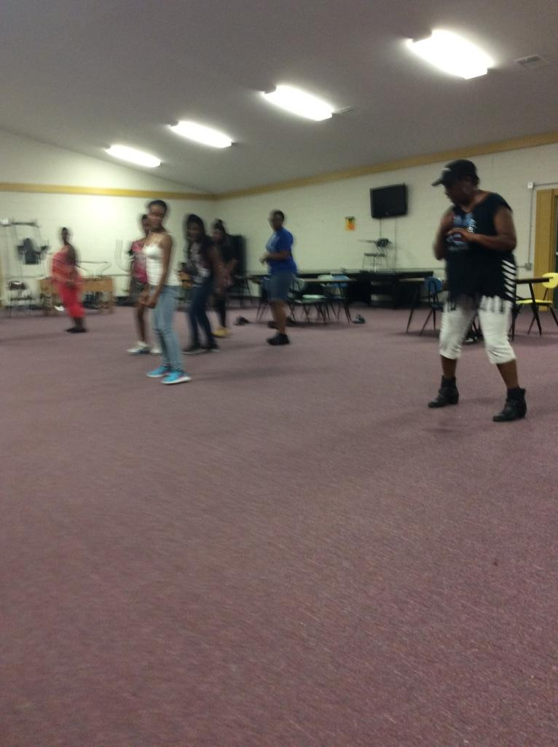
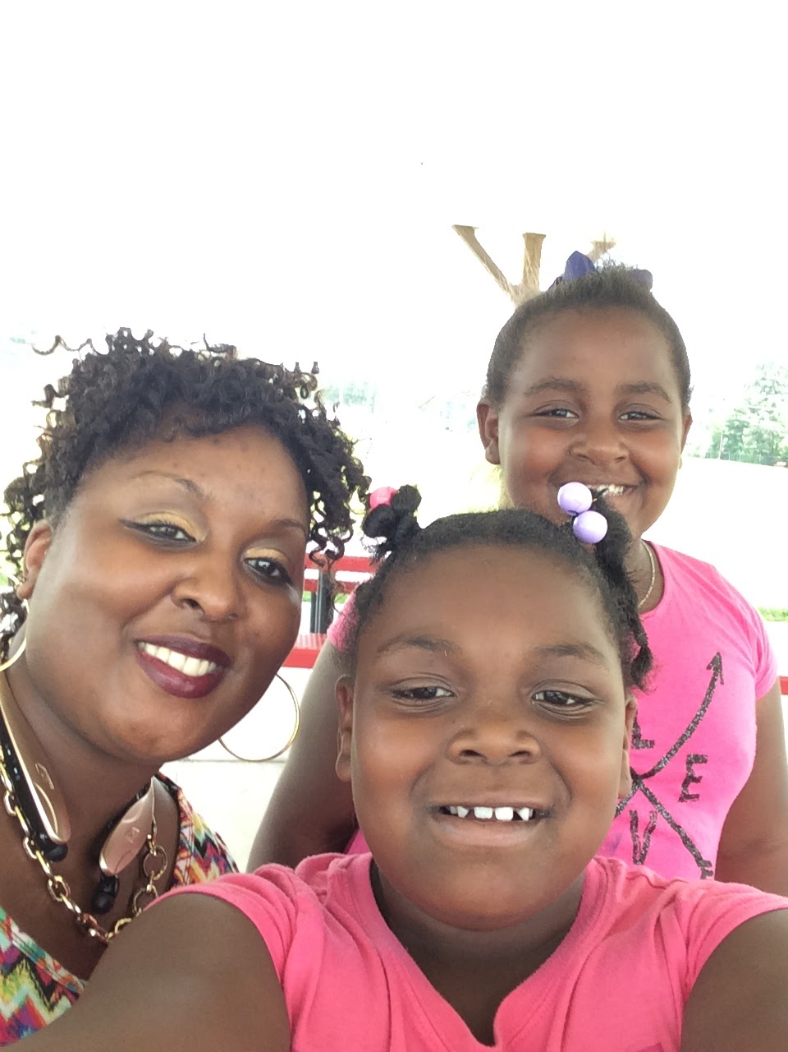
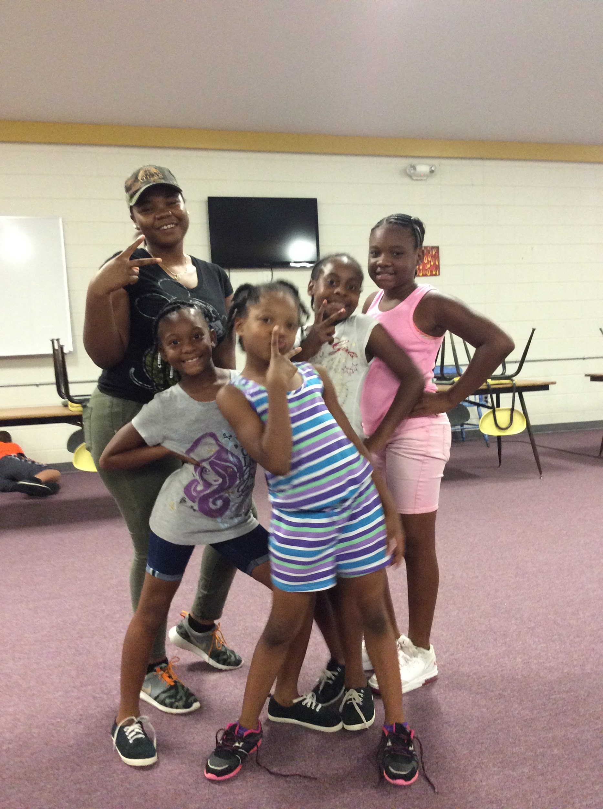
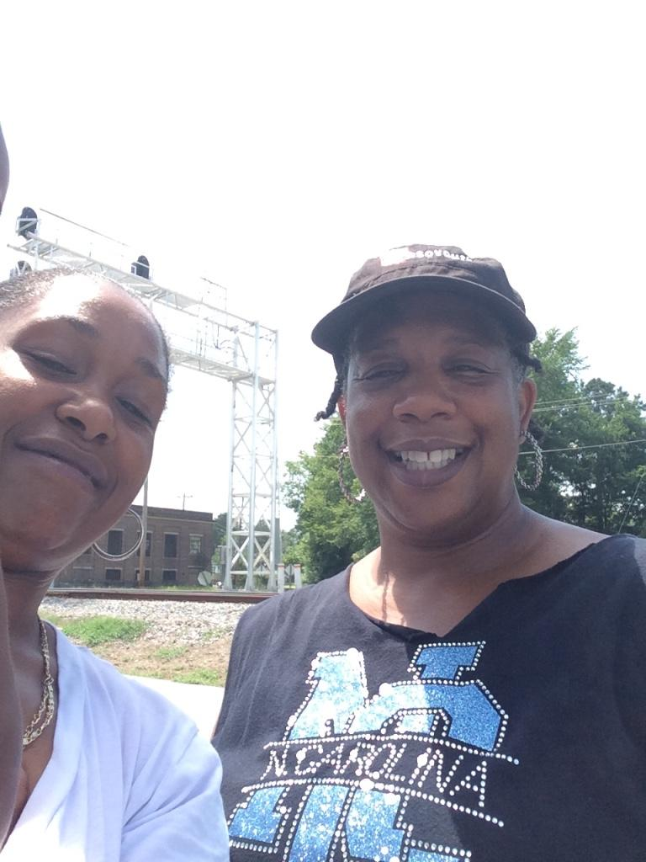
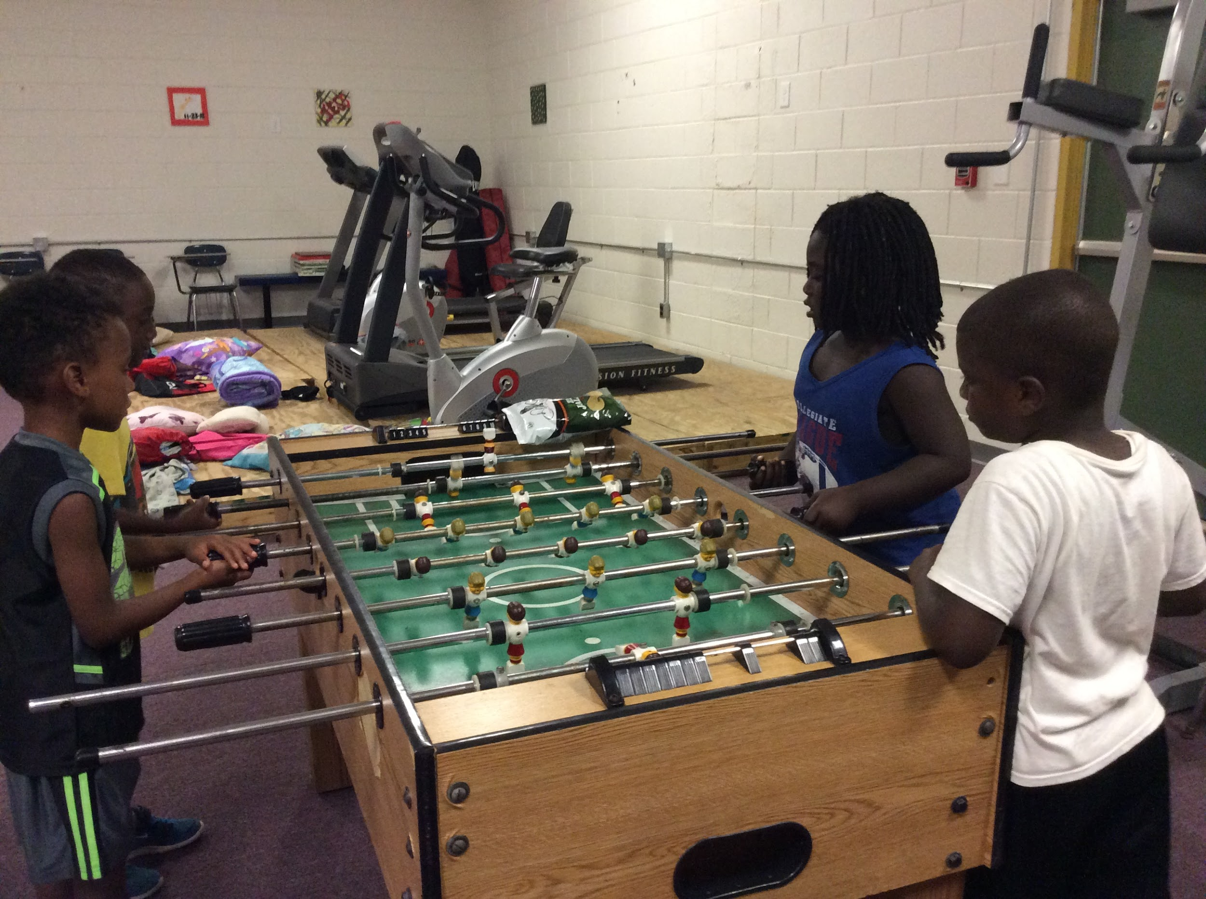
Summer Camp

Slide 12
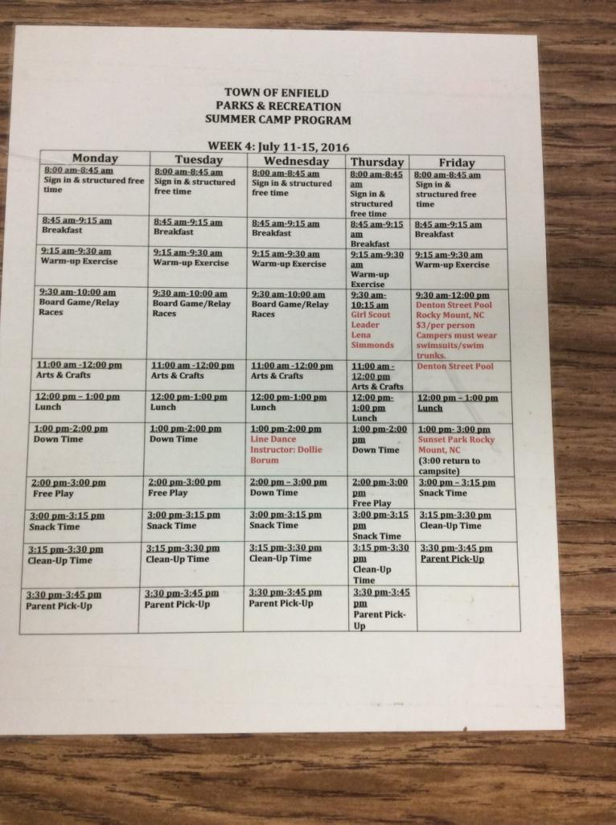
Photograph Permission Form
Behavior Tracking Document
Documents Created during Summer Camp

Slide 13
Summer Camp Testimonials
https://youtu.be/1pXNe6RttQ4
https://youtu.be/SupkkvdRZTk

Slide 14
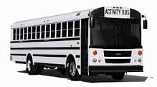
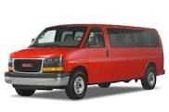

Where do we go from here?
Increase literacy by building a partnership with the Franklinton Center at Bricks
Contact various organizations to provide reliable transportation for remaining trips for the Summer Camp
Increase the number of volunteers for the organization
Build a partnership with the schools in the surrounding areas
Assist with community forum on August 20th
Help plan a more structured camp for the upcoming school year

